Slide 1
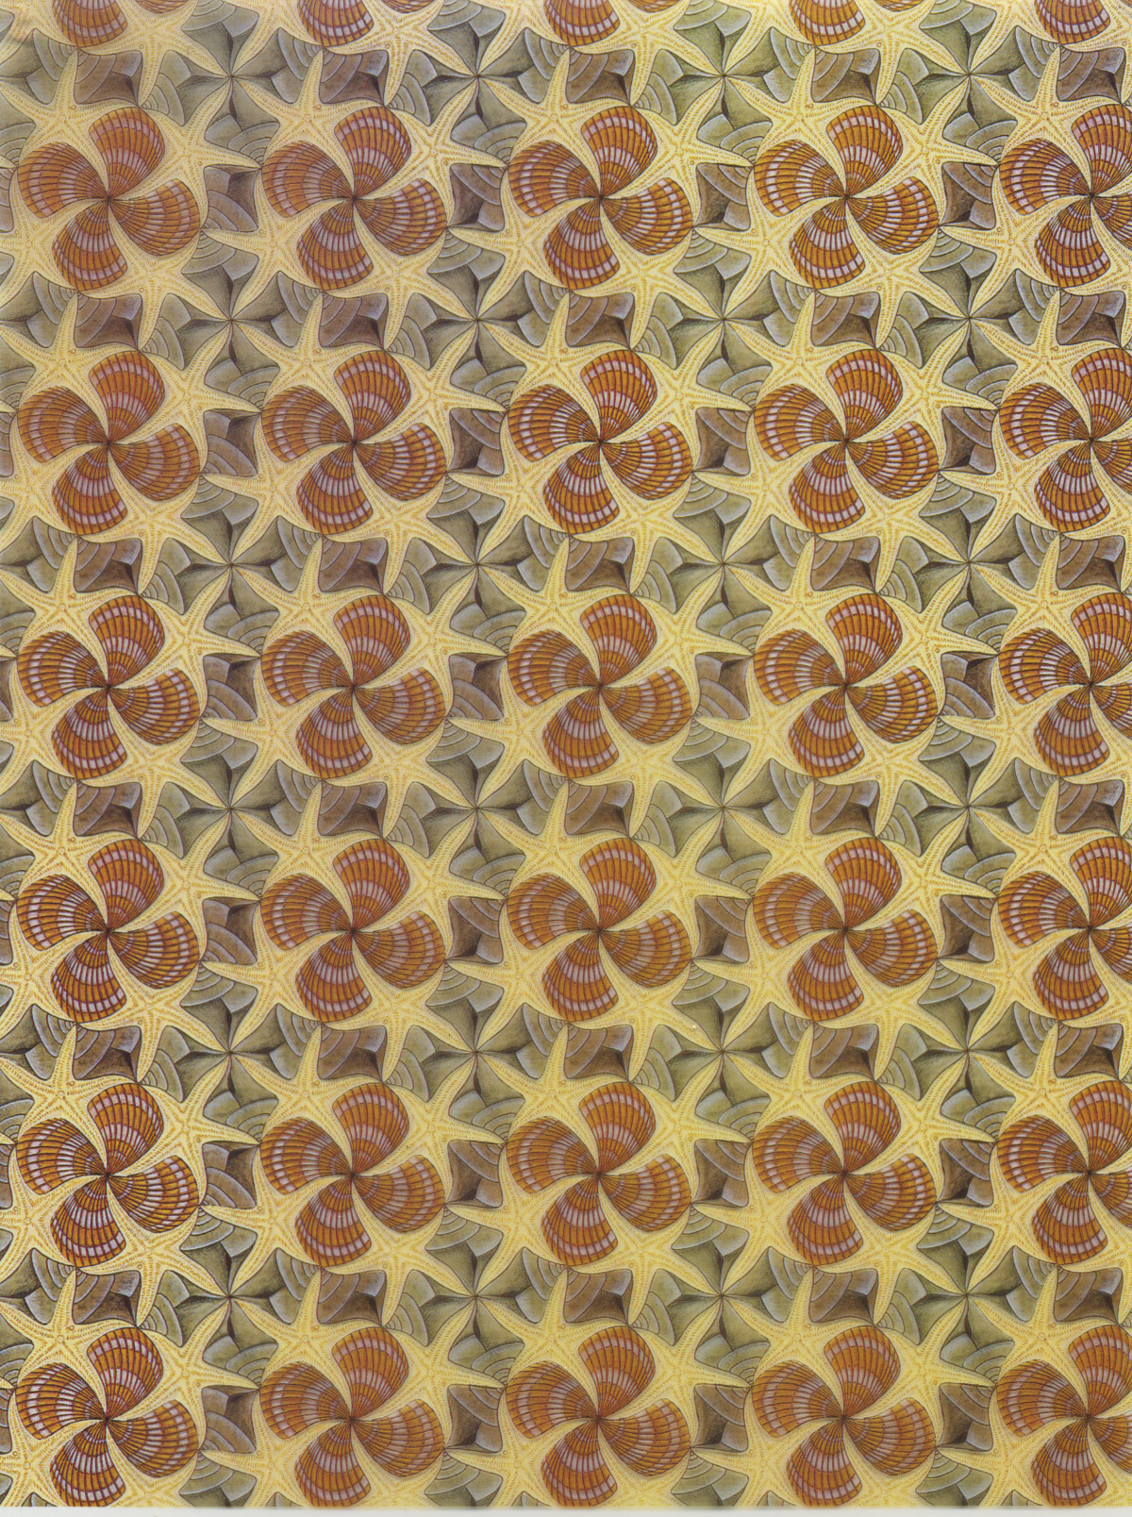
Notes:
Teaching mineralogy, Brady et al._Fig 5 Escher Pattern #43 (Shells and Starfish)

Slide 2
Notes:
Teaching mineralogy, Brady et al._Fig 5 Escher Pattern #43 (Shells and Starfish)

Slide 3
Characteristics of unit cells
  Contain all chemical and structural features of the entire crystal
  Enclose space
  Have parallel walls - 4 (2 pairs) if planar and 6 (3 pairs) if 3-dimensional
  Translating (moving) one parallel to its walls will result in an identical unit, i.e., it will not be possible to distinguish the moved cell from the original one
Notes:
Teaching mineralogy, Brady et al._Fig 5 Escher Pattern #43 (Shells and Starfish)

Slide 4
Notes:
Teaching mineralogy, Brady et al._Fig 5 Escher Pattern #43 (Shells and Starfish)

Slide 5
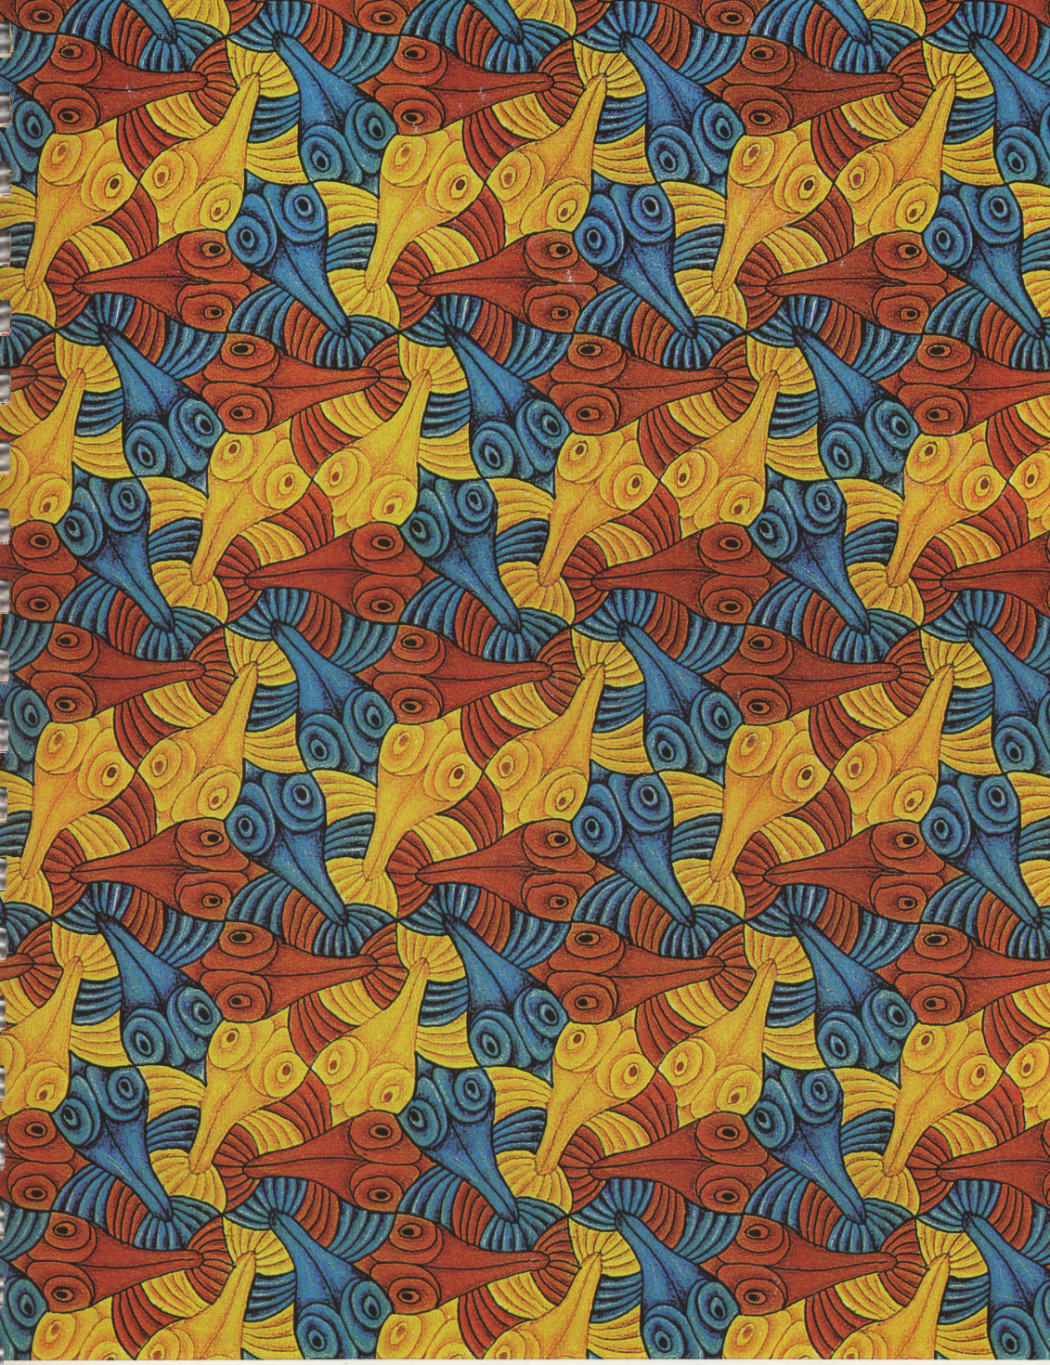
Notes:
Teaching mineralogy, Brady et al_Fig.1 Escher Pattern#55

Slide 6
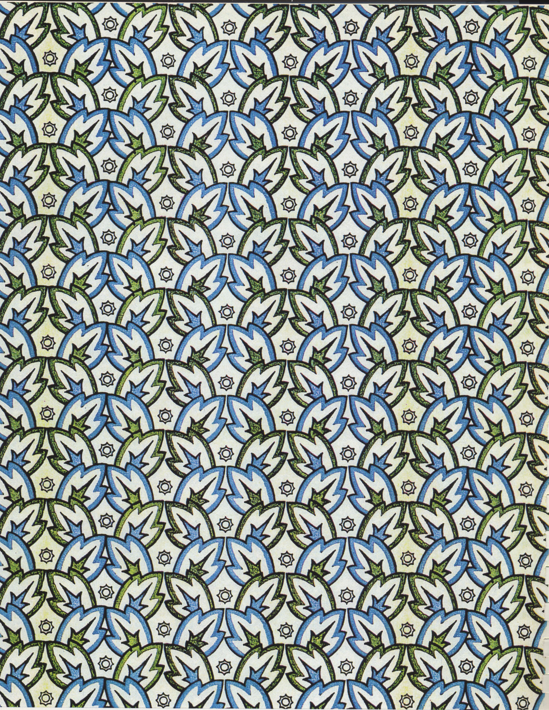
Notes:
Teaching mineralogy, Brady et al._ Fig. 4 Iselberg by Irene Schaschl

Slide 7
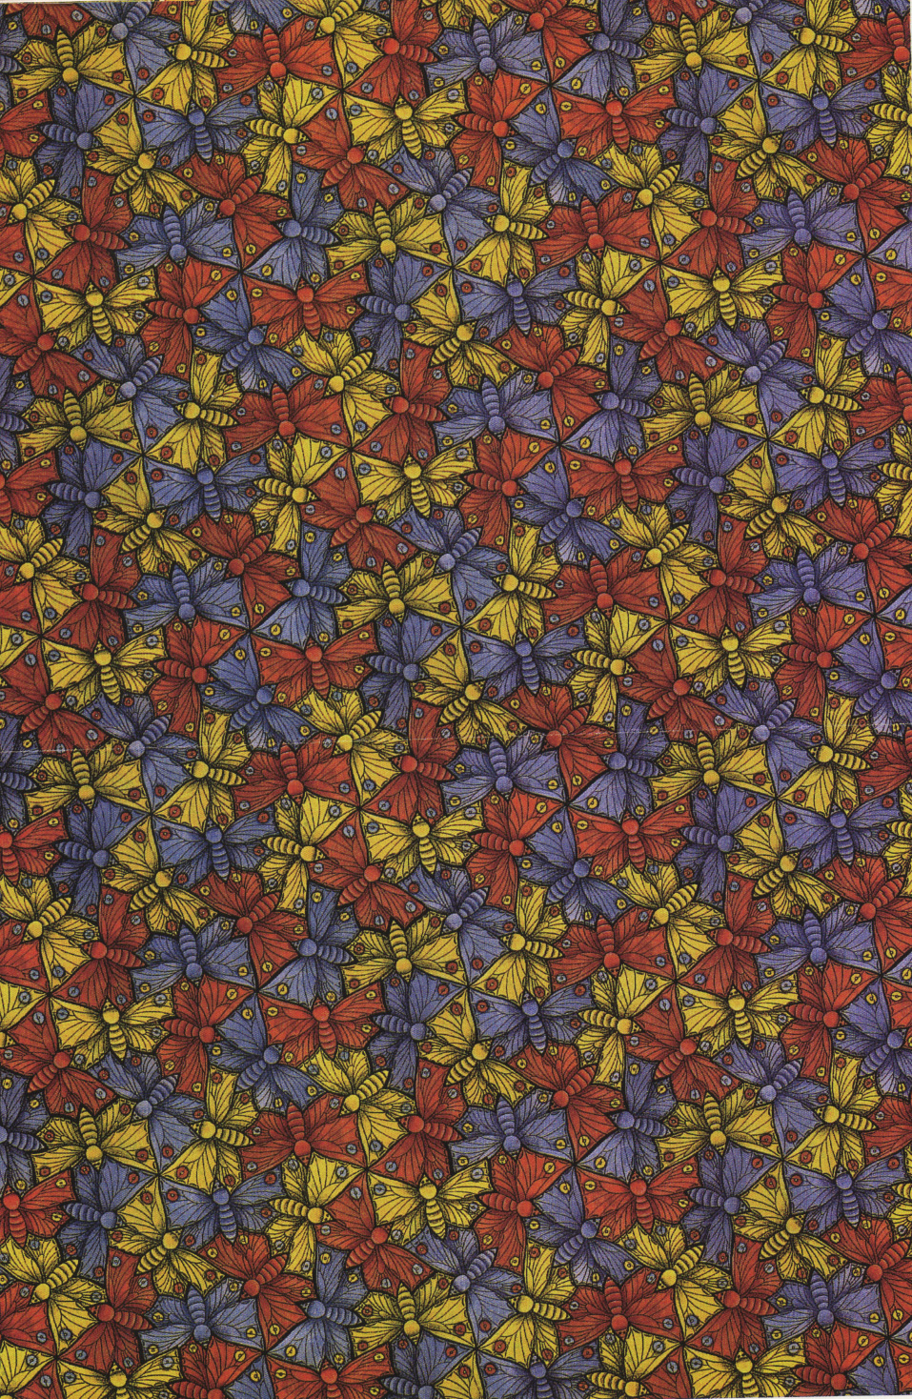
Notes:
Teaching mineralogy, Brady et al._Fig.2 Escher Pattern #70 (Butterfly)

