Slide 1

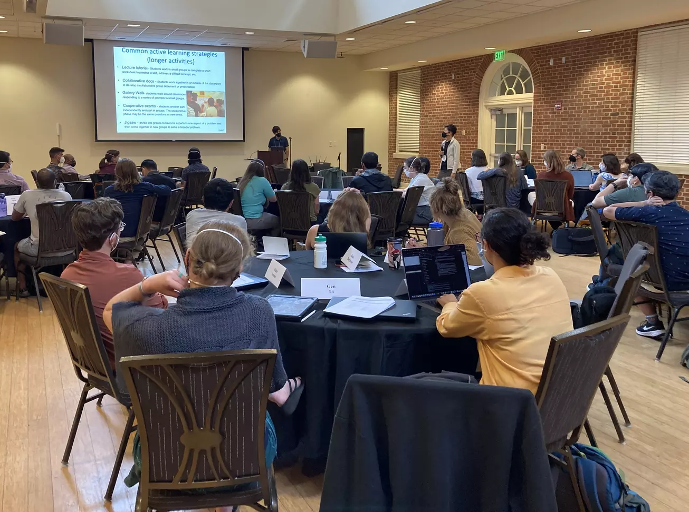
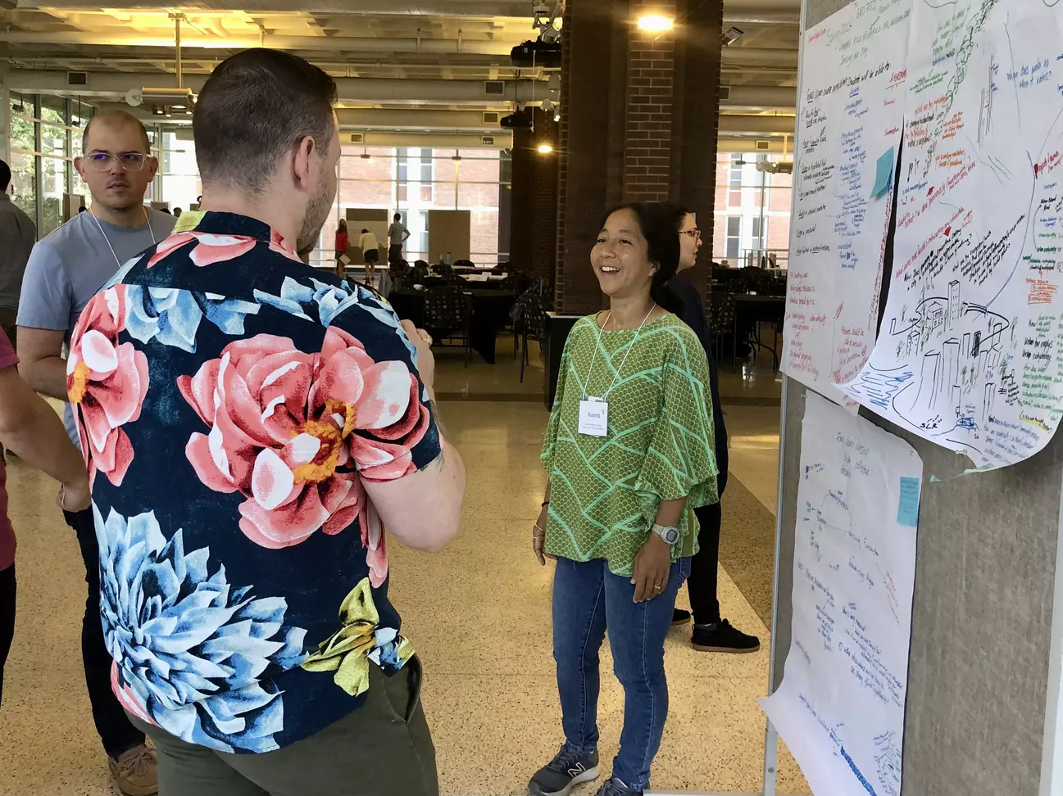
Early Career Geoscience Faculty Workshop 2026
June 21-25, 2026
Macalester College, St. Paul, MN
Application Deadline: March 31, 2026
National Association of Geoscience Teachers
If you are in your first three years of a faculty position, please apply to join us for a multi-day workshop in a stimulating and resource-rich environment where you will participate in sessions on topics including effective teaching strategies, course design, establishing a research program in a new setting, working with research students, balancing professional and personal responsibilities, and time management. Participants must have a faculty position at a two-year or four-year college or a university at the time of the workshop and must be in their first three years of teaching or starting a position in the Fall. The workshop is offered by NAGT On the Cutting Edge professional development program for geoscience faculty.
The registration fee for the 2026 workshop is $1800, and accommodations and some meals will be covered by this registration fee. Travel is not included in the registration fee and participants or their home institutions must provide transportation to and from the workshop. In cases where the cost of attending this workshop would cause financial hardship, you may be able to apply for a stipend to help defray these costs. The registration fee will be due in May after notification of acceptance into the workshop.
Course design plenary session, 2022 workshop
Early Career 2023 participants' poster session
Any questions? Contact the workshop conveners at:
earlycareer@nagt.org

