Slide 1
MGK MINES INDIA
LOCATION ---SEEMANDRA
RARE PEGMATITE
Mining lease
1998—2050
Private Family owned
208.99 acers
Precious & semi precious
Minerals

Slide 2

MGK INVITES

Slide 3
The Best Investment Destination
Prepared by Mrs.Geetha Dubey
Reg.Office : 119A,Krishna st.,
Palaniappa Nagar,Chennai -87
India
Mines- Uchapalli Village,Podalakur Mandal
Dist: Nellore A.P. Seemandra, India
Phone : 0091+44+24861755
Mobile: 0091+9841038155

Slide 4
C O N T E N T S
Geographic location 5
Andra Pradesh advantage 7
Macro Aggregates 13
Resources 17
Infrastructure 27
Manufacturing sector 59
Govt.Sectors 69
Govt.policies & initiatives 107
Project implementation 123
Key contacts 131

Slide 5
MESSAGE
FROM Mrs.Geetha Dubedi
I am happy to share with you that with the objective of providing best possible
information to the investors, Industries Department and AP Invest has brought out this
Booklet 'Doing Business with Andhra Pradesh'. I am sure that the contents of this book
will provide incite into congenial industrial climate built in Andhra Pradesh in India.

Slide 6
Message
From Mr.P.V.M.Swamy
While giving top priority to Agriculture, its allied sectors and Irrigation, the State
Government is exploring the possibility of setting up of more and more establishments in
Trade, Commerce and Industry to create, employment to youth in particular and the rural
population in general. A separate department of Infrastructure and Investments is created
to promote infrastructure development through Public-Private-Partnership. APInvest is
a nodal organisation, created with an objective of facilitating global investments to flow

Slide 7
Message
From Mrs.Usha Devi
into Andhra Pradesh. We are striving to evolve new strategies and policy initiatives and
minimize the cost of production through technical efficiency and effective management
in every sector. We have been striving to compete with global standards in enhancing
productivity both qualitatively and quantitatively

Slide 8
Message
From Mr.Kishore Kumar
I hope this endeavor of ours will focus its attention to bring about awareness among
Business Leaders, Investors, Entrepreneurs and officials of various departments about
the huge investment opportunities as well as the infrastructure facilities in Andhra
Pradesh. I also hope that the book would be a source of information for the entrepreneurs
both within the country and abroad, and help the entrepreneurs to come forward with
huge investments in the core sectors of development all over Andhra Pradesh.
I wish the efforts all success.

Slide 9
Strategic Geographic
Location Advantage
Andhra Pradesh is strategically and caressed by Bay of Bengal in east.
located in India. It has easy access to The state also shares its boundaries
all parts of the country. Country’s with Tamilnadu and Karnataka in the
capital, New Delhi is less than two south and with Maharashtra in the
hours fly from Hyderabad. Populous west. Hyderabad, the State capital is
MGK MINES INDIA 65 kms from Krishnapatnam Port

Slide 10
and Business states like Uttar Pradesh, centrally located and exudes a huge
Gujarat, Maharashtra, West Bengal, potential to be transformed into a
Tamilnadu and Karnataka are at just 1 transit hub of South Asia. It has in the
to 1½ hours flying distance. Strategic recent years become prominent as
location of the state is very preferred destination for leading
advantageous for the business to have software services companies
the best domestic market in country,
easy to reach all corners of the
country

Slide 11
Andhra Pradesh is known as Gate of
South-East Asia. Easy access to the
most economically developed
countries like Japan, Philippines,
Singapore, Malaysia, Hong Kong,
Thailand, New Zealand, Australia. Visakhapatnam port in AP is the
largest cargo handling port in the
Andhra Pradesh is richly endowed with country which provides a major share
natural resources and competitive of cargo to south east Asian countries
advantages with geographical area of and Australia.
274.40 lakh hectares being the fourth

Slide 12
largest state accounting for 8.37% in The State have easy access of less
India with population of 81.60 million than 4 hours fly to Global Oil capitals
being the fifth most populous state of Gulf countries and another 4-5
accounting for 7.4% in the country

Slide 13
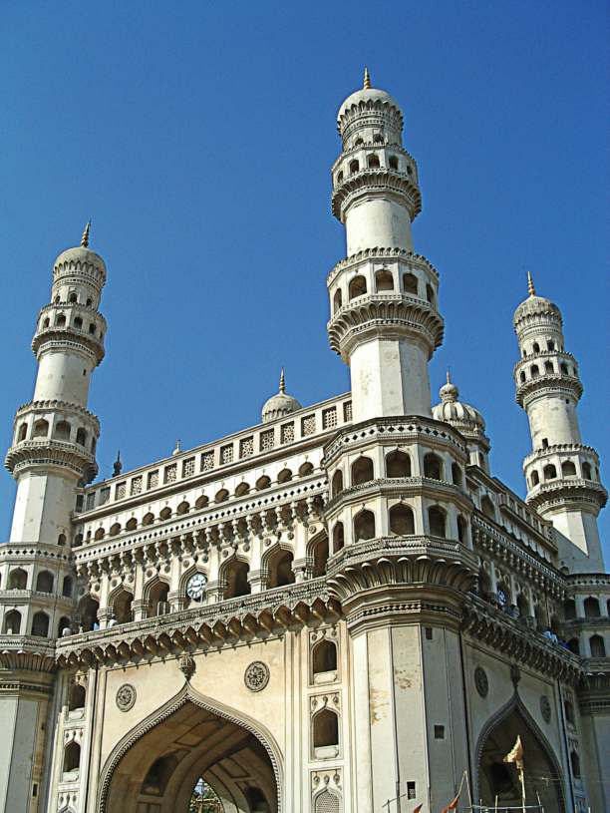

Slide 14
Advantage

